Slide 1

Data Used
"Foster Trends in America”:
https://www.acf.hhs.gov/cb/resource/trends-in-foster-care-and-adoption
“Child Maltreatment 2011”
  https://www.acf.hhs.gov/sites/default/files/documents/cb/cm11.pdf
“Voices for Children”
https://www.speakupnow.org/foster-care-statistics-resources/

Slide 2
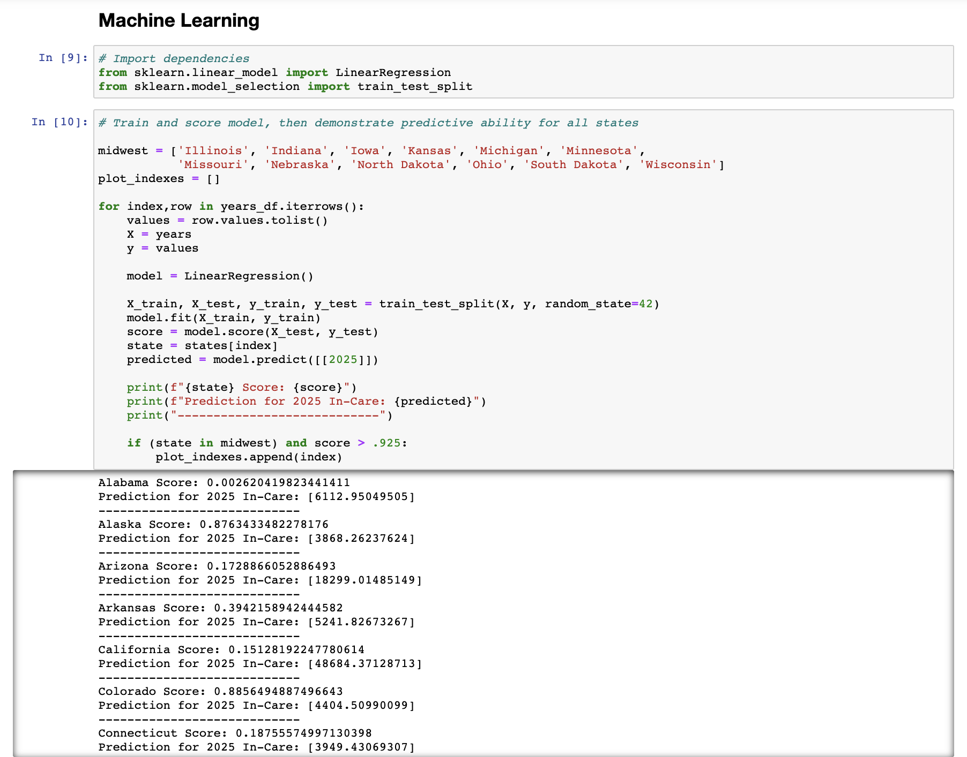
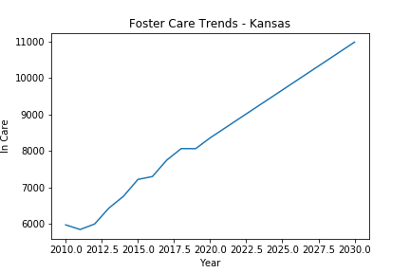
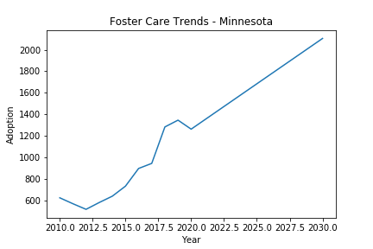
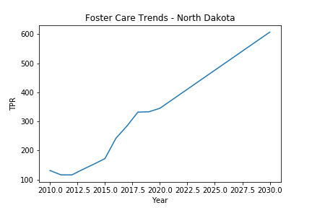
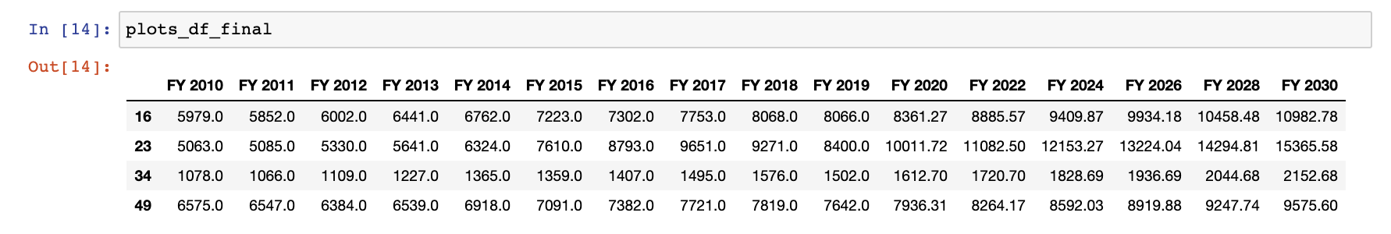
Machine Learning: Trends

Slide 3
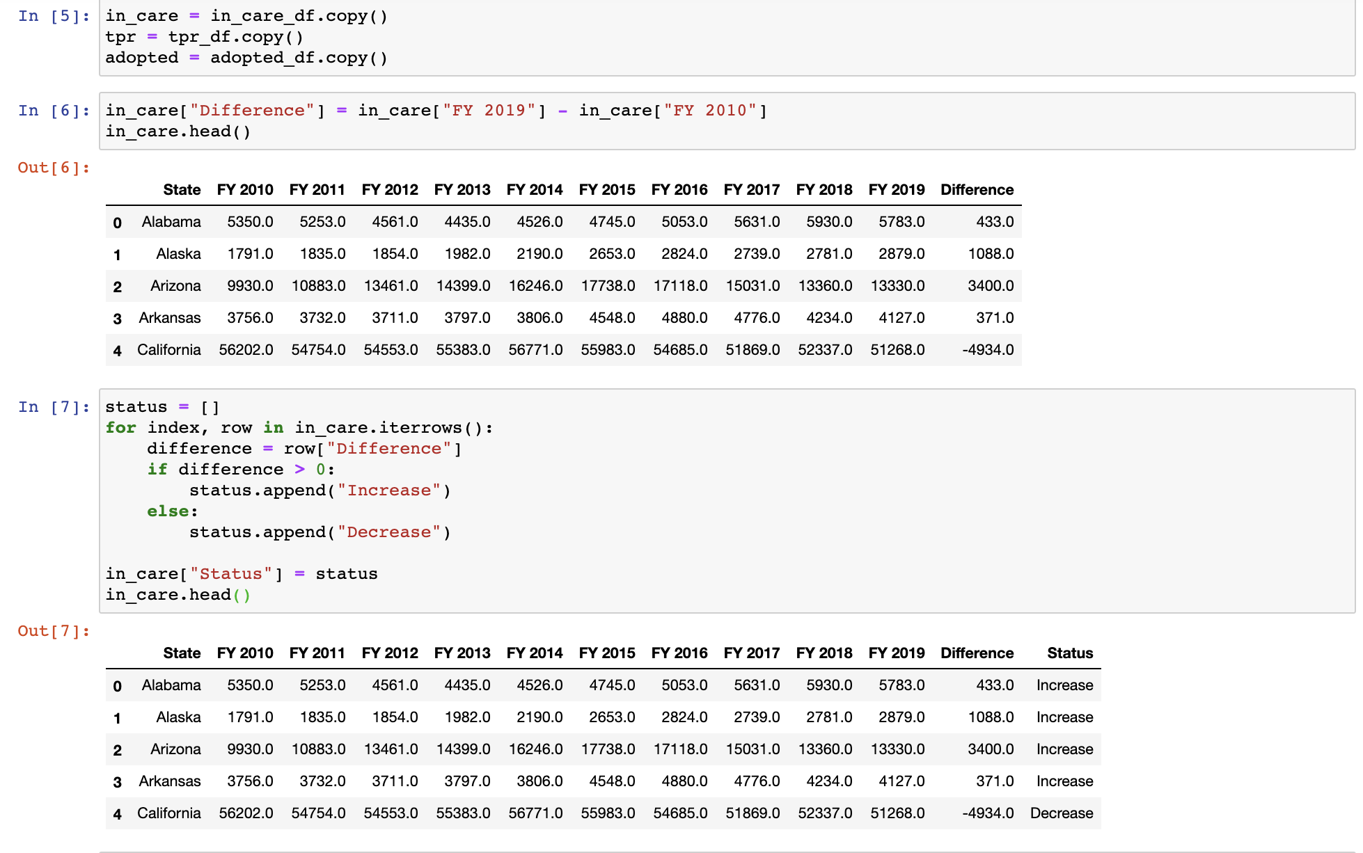
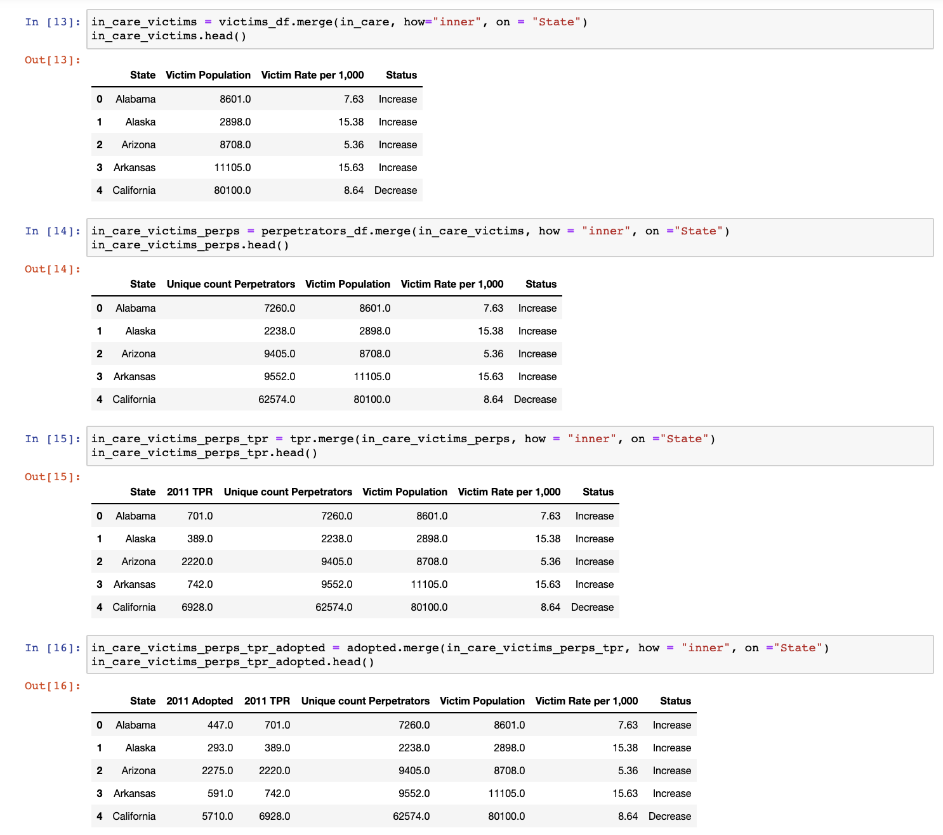
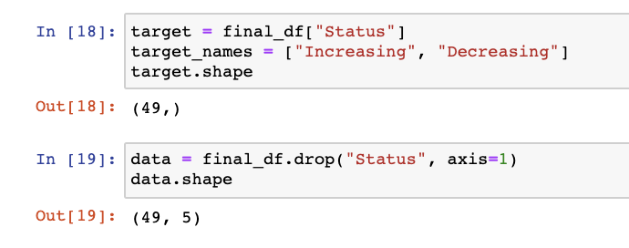
Data Cleaning
Convert numerical data to categorical data
Rename columns, filter dataset to desired features
Joins, joins, and more joins…
Shape and reshape

Slide 4
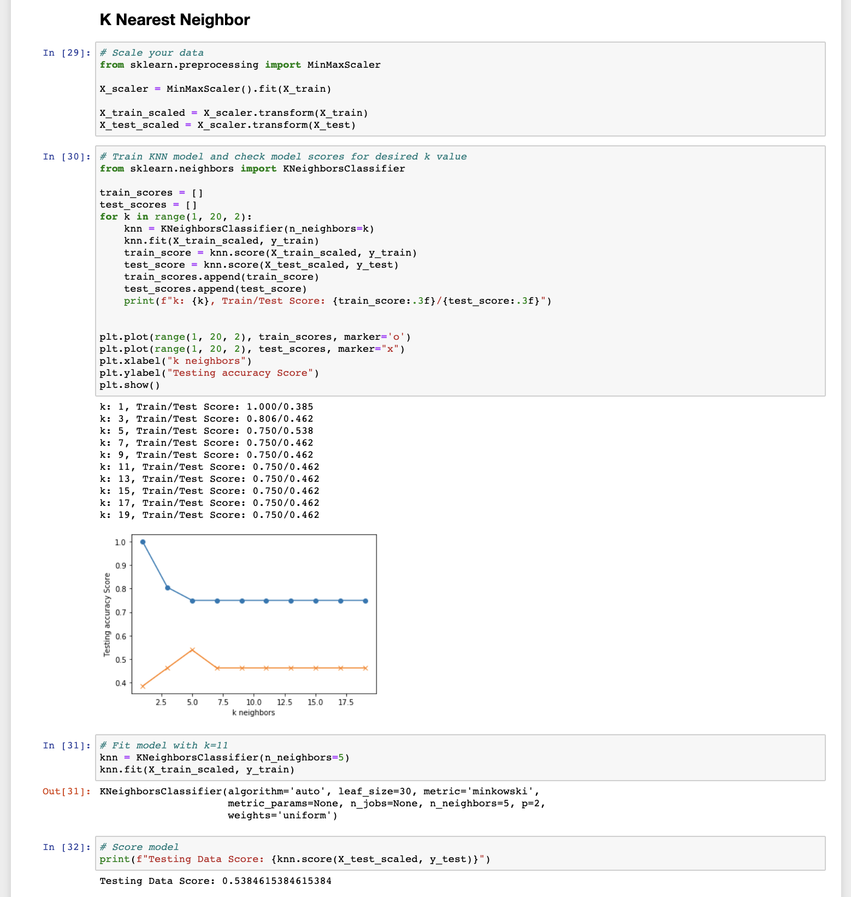
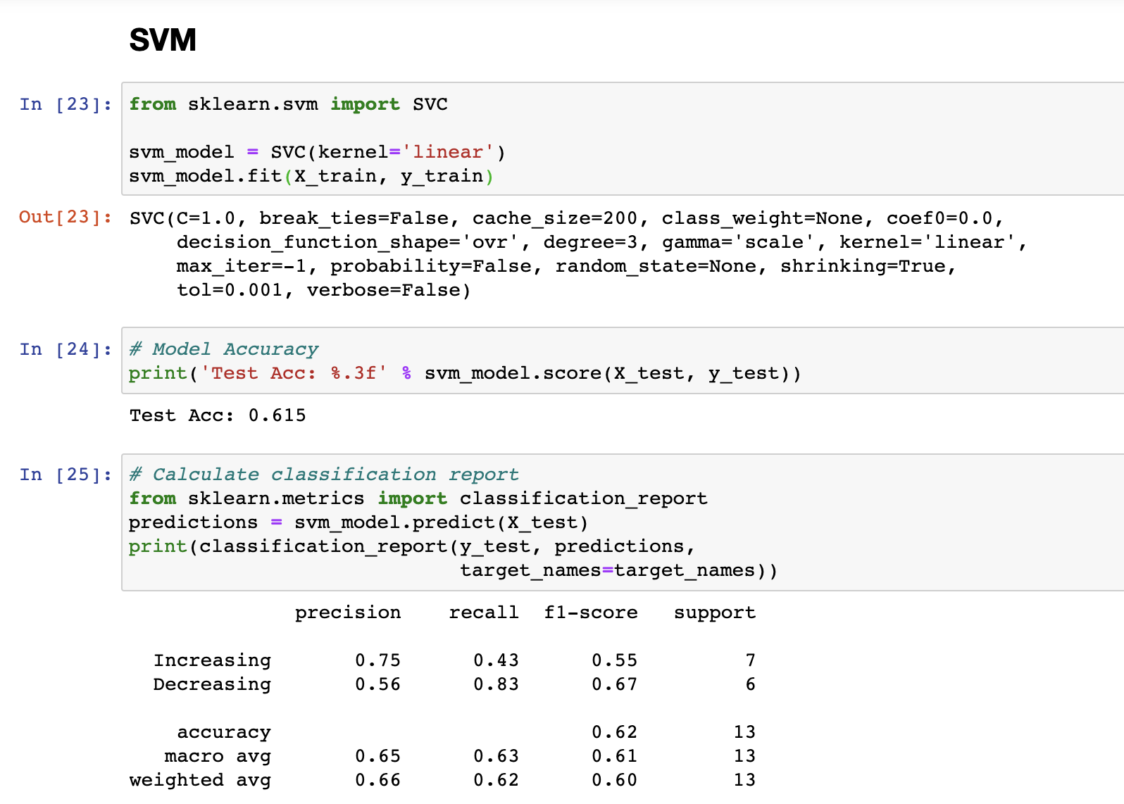
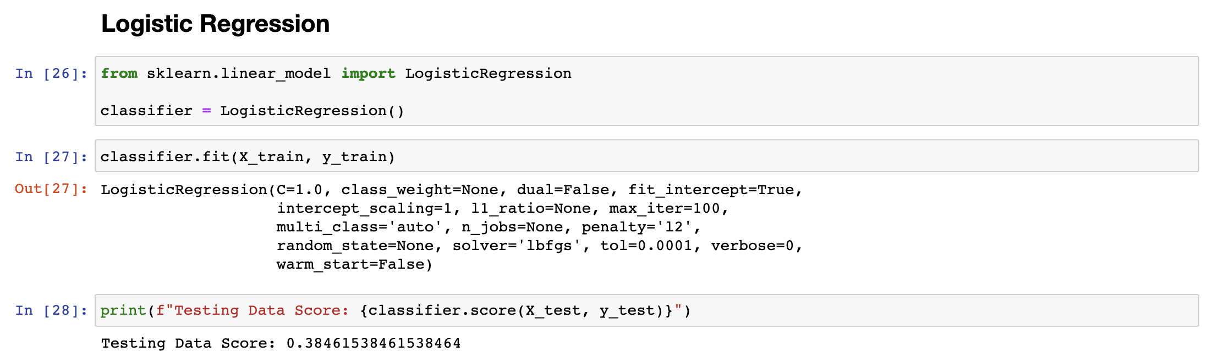
Machine Learning: Categorical
Notes:
Line spacing + Page numbers

